Slide 1
Resistive Touch Screen Controller
STMPE610
By: Sahil Saini
My github link: https://github.com/sahilsaini0014/ResistiveTouch

Slide 2
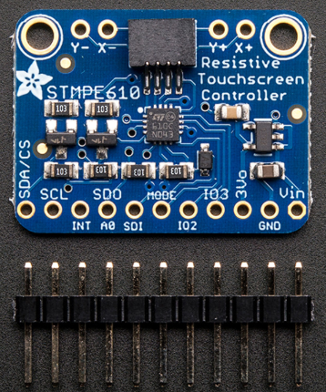
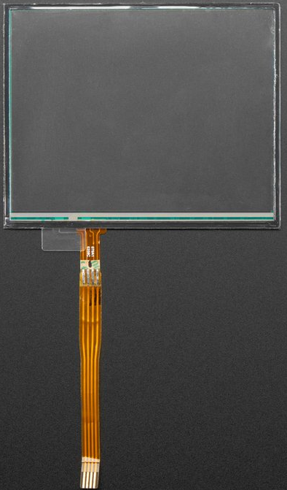
STMPE610 Controller
Resistive Touch Screen

Slide 3
Proposal
So as I already showed you guys my Controller and the touch Screen. So In this semester I have developed a hardware from which I can get readings of position and pressure applied on the touch screen. In the next semester I am using this Screen to operate our device(Smart Health Tracker) that I am making with my two group partners.

Slide 4
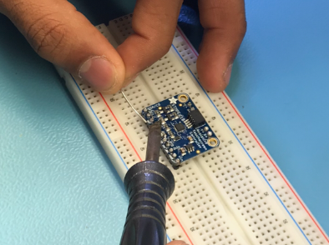
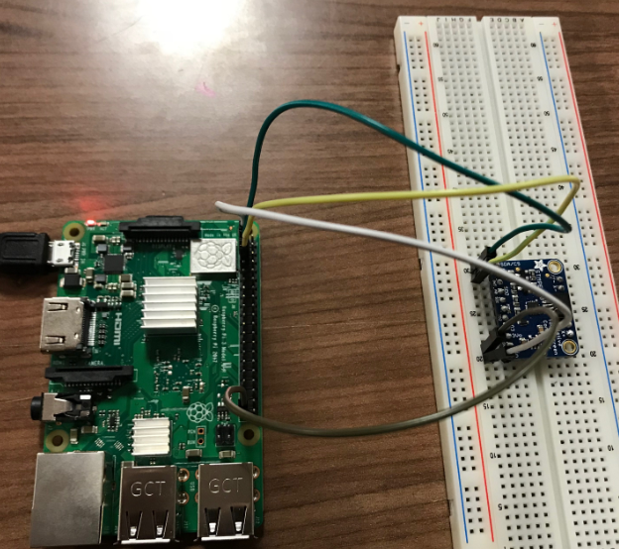
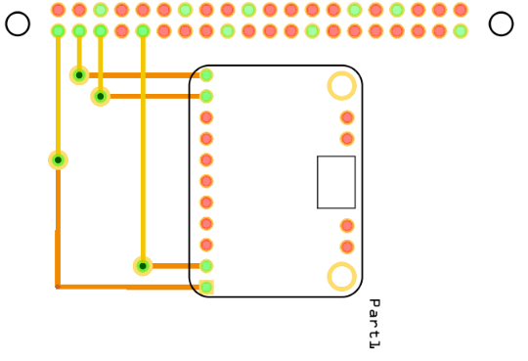
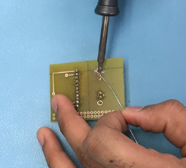
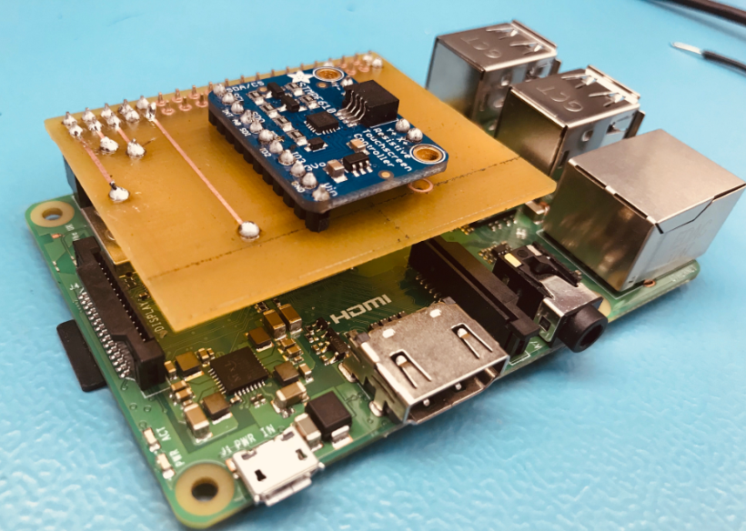
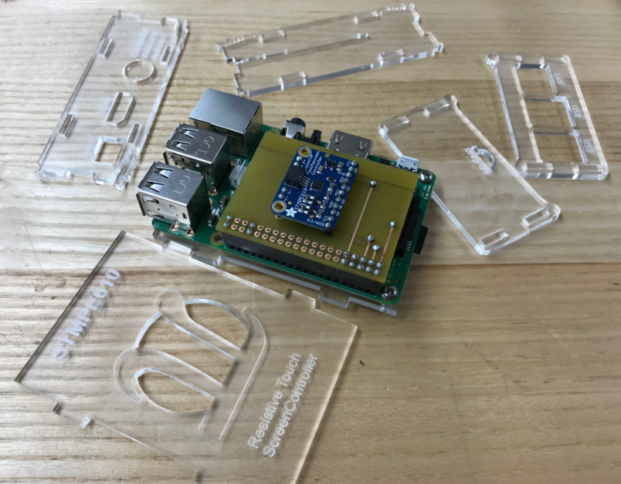
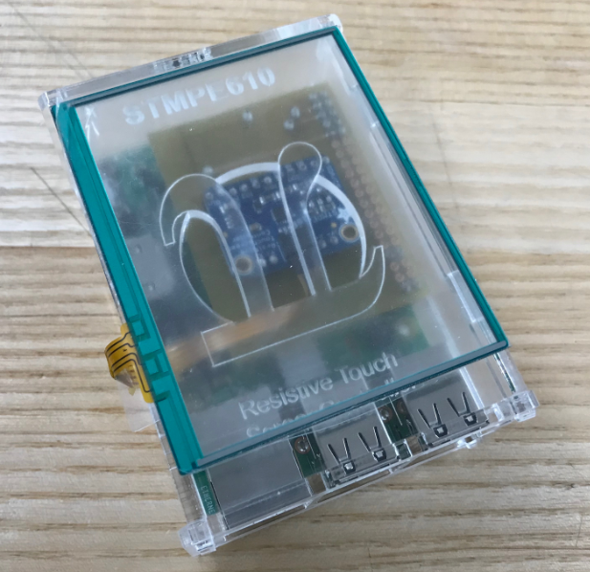
Schedule
I have done each part of my project at time without delaying anything Except powering up the PCB. The PCB power up was due on week 11 but, due to some errors in my code I was not able to finish that at time. But I was Successful to do it in week 12.

Slide 5
Budget
Item | Supplier | Price
Raspberry Pi 3 Model B+ | Canakit | $70.75
STMPE 610 Controller | Adafruit | $26.24
Resistive Touch Screen | Adafruit | $6.72
Jumper Wires | Amazon | $11.29
Sandisk ultra 16Gb micro | Amazon | $13.62
Total |  | $128.62
So this is the budget I made in week 4. After that I didn’t buy anything for my project. I got my PCB and Case for the Hardware from Humber Prototype lab for free.

Slide 6
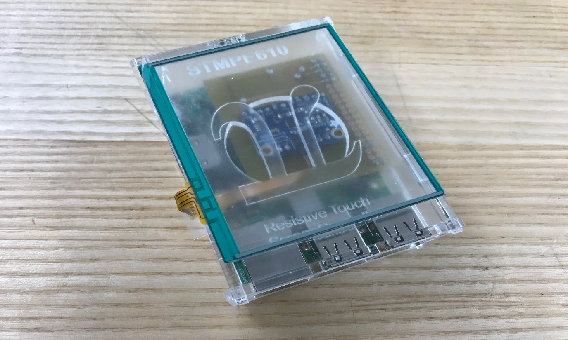
Enclosed Hardware
So this is my enclosed hardware in custom made case that contains of Raspberry Pi, PCB, Stmpe610 Controller and Touch Screen attached on the top of the Case.

Slide 7
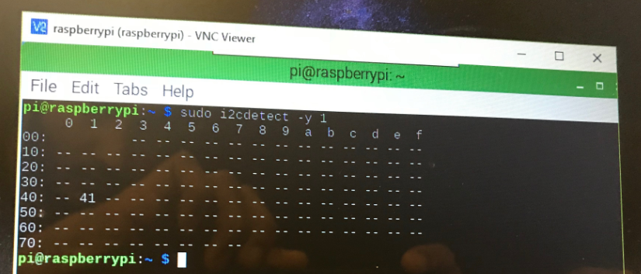
Controller Address 0x41
My Controller address is 0x41. After connecting my controller with my raspberry Pi I can see my controller address on the terminal of my raspberry pi by typing the command: sudo i2cdetect –y -1

Slide 8
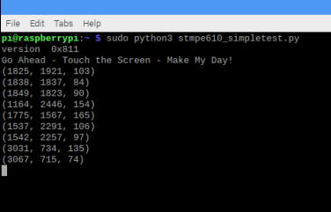
Readings
Above are the readings that I got from my controller. So These are the –X and –Y coordinates touched on the Screen and Third one is the pressure applied on the Screen.

Slide 9
Knowledge from previous courses
CENG 209 Micro Assembly Language Programming
WRIT 220 Technical Workplace Writing Skills
CENG 256 Internet Programming
CENG 252 Embedded Systems

Slide 10

Thankyou so much.

